Slide 1
Session 5 – Sligo PPN TidyTowns Support - Open Session

Slide 2
Session 5 Topics to include: Circular Economy UN 2030 Sustainable Development Goals (SDGs) & TT TidyTowns Supports in Future Measure Actions – collation of data and successes

Slide 3
Buzzwords for Communities:
Sustainable Development Goals
Circular Economy

Slide 4
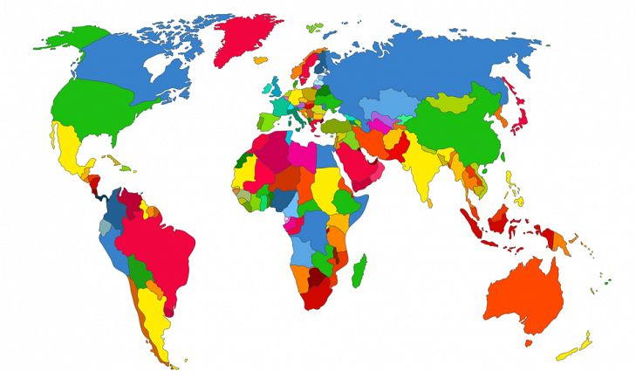
United Nation’s 2015-2030 Road Map for Sustainable Development
7.7 billion People
193 Member States
Community
A better World
Environment
1 Planet
17 Goals

Slide 5
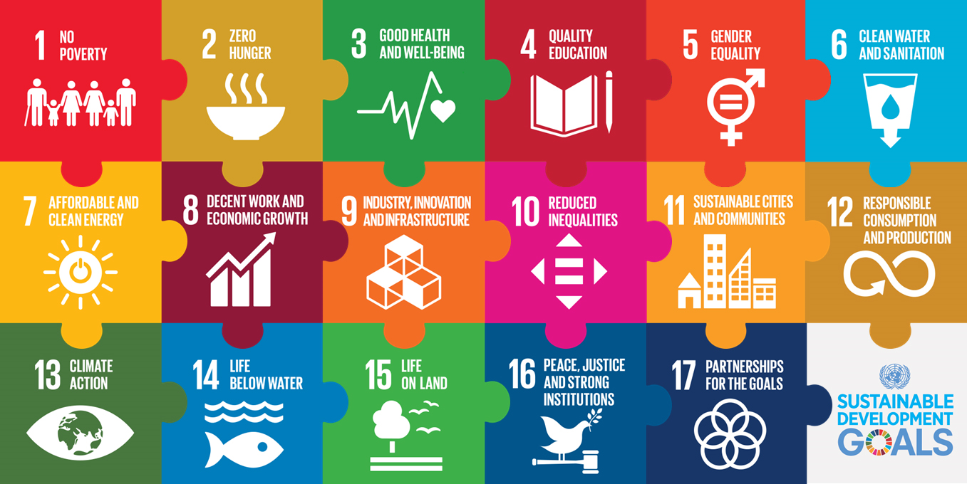
17 Sustainable Development Goals
In September 2015, 193 UN Member States adopted the 2030 Agenda for Sustainable Development ("Transforming our World"). The centre piece of the 2030 Agenda is the 17 Sustainable Development Goals (SDGs), with 169 targets. The 17 SDGs reflect economic, social and environmental dimensions of sustainable development.

Slide 6
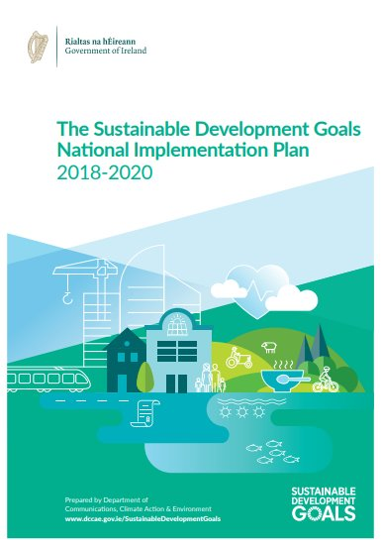
What is Ireland doing?
Sustainable Development Goals National Implementation
Plan.
The Plan indicated a coordinated whole-of-Government
approach to implement the SDGs.
Selected, from applicants, Sustainable Development Champions To promote and implement the 17 Goals and ensure that they are incorporated into plans and strategies

Slide 8
How can the SDGs link to TidyTowns
Anti-Litter and Anti-Graffiti .
Local Environment Action Fund (Formerly LA21).
Collaboration – PPNs,
Act Local - Think Global.
Additional Initiatives which will include SDG branding and at local Tidy Towns/National Spring Clean/ Gum Litter Task Force

Slide 9
Support your local Charities & Voluntary Groups
Local Shoe Box Appeal
Take one /leave one behind
Include marginalised individuals

Slide 10
Edible Landscapes
Free Nutrition Classes
Grow It Yourself

Slide 11
Walk in the woods, volunteering & Connecting
Support local Mental health Association
Connect in with your community for change
Gardening
Community Check in

Slide 12
Book Swap
Free community Library
Skill Share

Slide 13
Peer Support Groups
Men's Emotional Wellbeing
Support Domestic Violence Shelters

Slide 14
Drink from the Tap!
Refill.ie
Ask the Green school kids!!!
Keep Cup Bottles

Slide 15
Ask the Green school Kids – Energy Vampires
Energy saving community led initiatives
Learn to read your bills – Workshop
Plug out , turn off

Slide 16
Shop Local
Community based workshops
Community driven activities/festivals

Slide 17
Local Markets
Energy Co-ops
Greenways
Work with industry in your communities
Such as Supervalu

Slide 18
Look at social inclusion in your area
Join or start a Befriending initiative
Local Information points

Slide 19
Future-proofing your community
Do you have a local Village plan?
Develop and protect our Heritage locally
Tidy Towns is key for developing a
strong sustainable community

Slide 20
My Waste
Stop Food Waste Programme
Environmental Policy -Ditch the disposables
Reuse, Recycle, Upcycle
Conscientious Consumerism think Local

Slide 21
Climate Action Plans local impacts
Conscious Cup
Single Use Plastic free
The Future is Local

Slide 22
Save the fishes!!
Pollution free rivers, protect the waterways.

Slide 23
Annuals vs. Perennials
Plant a Tree
Traditional Skills workshops
Think Native- what do you know about your local habitat?

Slide 24
Local Communities are the experts
Comhairle Na nÓg
Local Groups

Slide 25
This is all of you talking to everyone else:
Social
Environmental
Economic
Tidy Towns Communities can be a centre piece of Partnership for the Goals

Slide 26
SDG Mobile Phone Apps
Concept good - not updated since covid.
Important to track collectively your actions – great for the county – watch this space.

Slide 27
SDG Linking the SDGs to TidyTowns actions

Slide 28
Summary LTP on A3– sorted by category & year.

Slide 29
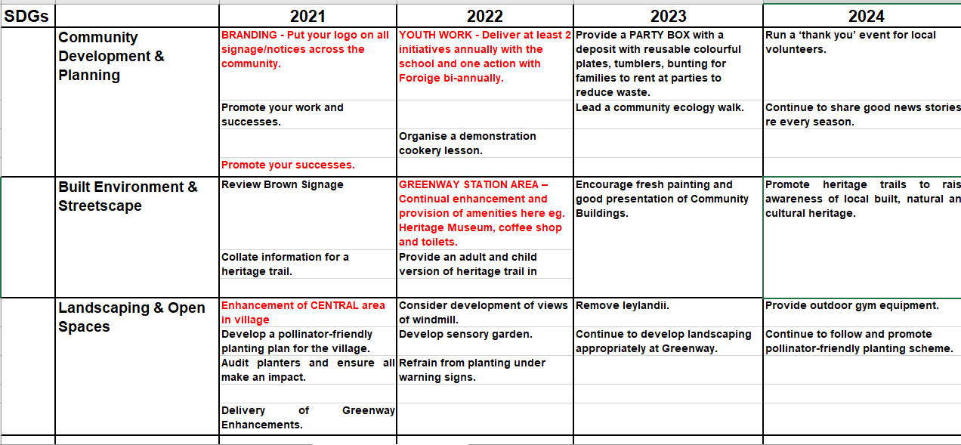
Linking Plan to SDGs

Slide 30
Actions on working Foroige:
GOAL | TARGET | RELEVANT ACTIVITIES FOR COMMUNITY GROUPS
Goal 4. Ensure inclusive and equitable quality education and promote lifelong learning opportunities for all | 4.4 By 2030, substantially increase the number of youth and adults who have relevant skills, including technical and vocational skills, for employment, decent jobs and entrepreneurship | Youth Activity for skills development
 | 4.7 By 2030, ensure that all learners acquire the knowledge and skills needed to promote sustainable development, including, among others, through education for sustainable development and sustainable lifestyles, human rights, gender equality, promotion of a culture of peace and non-violence, global citizenship and appreciation of cultural diversity and of culture’s contribution to sustainable development | education for sustainable development, social, environmental, and cultural sustainability and heritage

Slide 31
Promote Greenway & supporting Infrastructure
Goal 9. Build resilient infrastructure, promote inclusive and sustainable industrialization and foster innovation | 9.1 Develop quality, reliable, sustainable and resilient infrastructure, including regional and transborder infrastructure, to support economic development and human well-being, with a focus on affordable and equitable access for all | sustainable infrastructure
 | 9.4 By 2030, upgrade infrastructure and retrofit industries to make them sustainable, with increased resource-use efficiency and greater adoption of clean and environmentally sound technologies and industrial processes, with all countries taking action in accordance with their respective capabilities | reduce carbon emissions in infrastructure and industry

Slide 32
What is circular economy?
Activities that prevent waste
Resources are used for longer
Products are:
Well designed
Durable
Last longer
Allow recovery of EUs 27 critical raw materials
45% of the actions identified as action for climate change

Slide 33
Circular Economy Grant Applications:
Deadline 5pm 28 May 2021
Community & Voluntary Groups & community businesses can apply – funding around €10K
Funded by Dept Environment, Climate & Communications (DECC).
Fund projects that others can copy.
Areas of funding:
Plastics (<30% EU plastics collected for recycling)
Construction & Demolition (largest waste stream, by volume).
Food Waste
Resources & Raw Materials (esp textiles, furniture, electrical equipment)
https://www.gov.ie/en/service/b3faa-apply-for-the-circular-economy-innovation-grants-scheme-ceigs/

Slide 34
Possibly funded?
Repair shops
Food waste / biogas initiatives
Red door – school book & uniforms re-use.
Nappy Schemes?
Reusable/Refill schemes.

Slide 35
Support going forward for Sligo TT:
https://irelandsdg.geohive.ie/
Training programmes on going and to commence:
Biodiversity Training Sligo LEADER starting next week
PPN Environmental Training
SDG Local Champion to open shortly.

Slide 36
Planting Slide I borrowed from Eimear Fox:

Slide 37
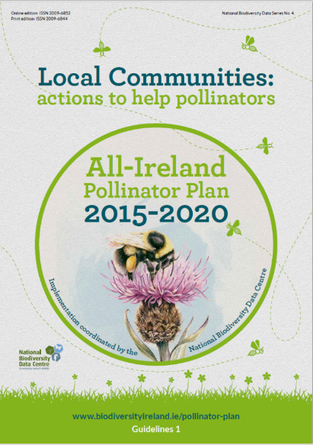

Slide 38
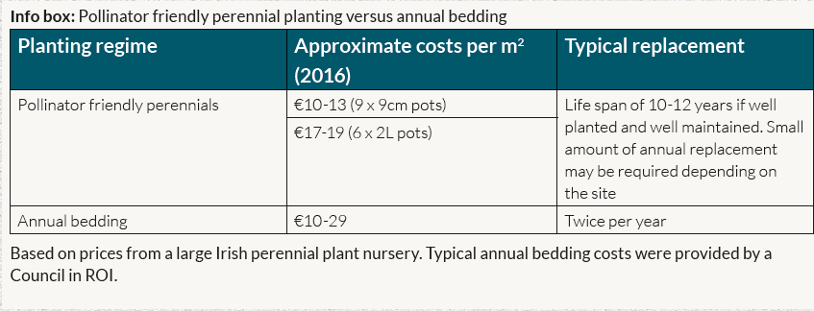

Slide 39
Annual bedding €20 x 2 = €40 per m2 per year
Perennial €15 = €15 per m2 per year

Slide 40
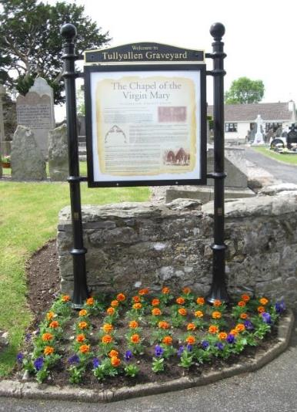
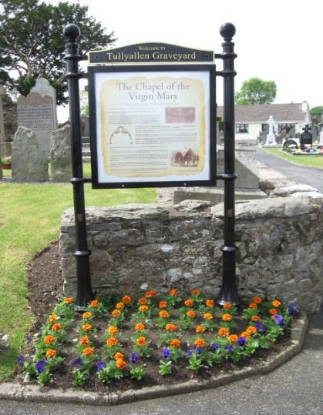
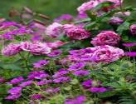
Over 8 years
Bed 2.5m x 3m = 7.5m2

Slide 41
Over 8 years
Bed 2.5m x 3m = 7.5m2
Annual bedding €40m2 x 8 years = €320 per m2 x 7.5ms = €2,400.00

Slide 42
Over 8 years
Bed 2.5m x 3m = 7.5m2
Annual bedding €40m2 x 8 years = €320 per m2 x 7.5ms = €2,400.00
Perennials €15m2 x 1 time only = €15 per m2 x 7.5ms = €112.50

Slide 43
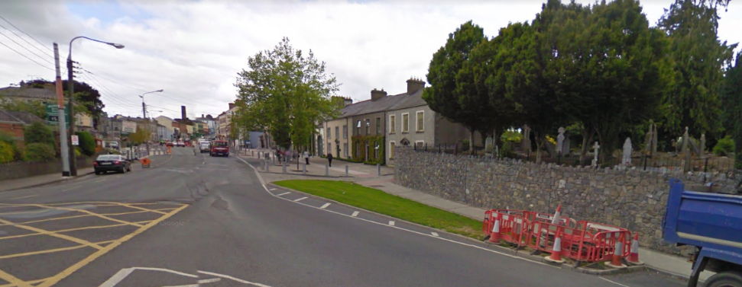

Slide 44
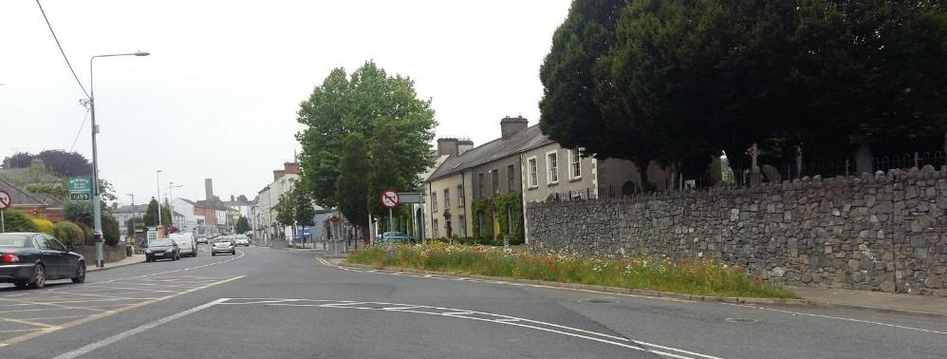

Slide 45
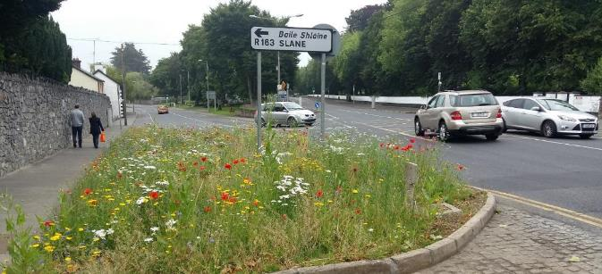
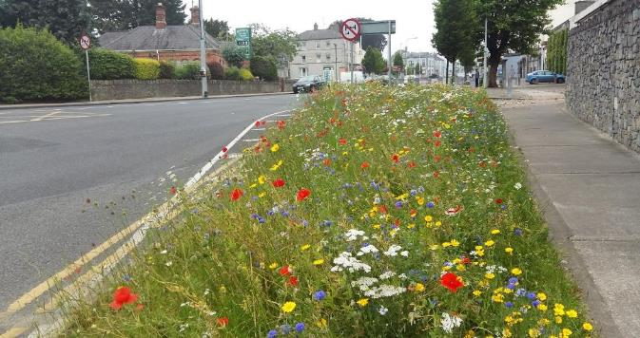

Slide 46
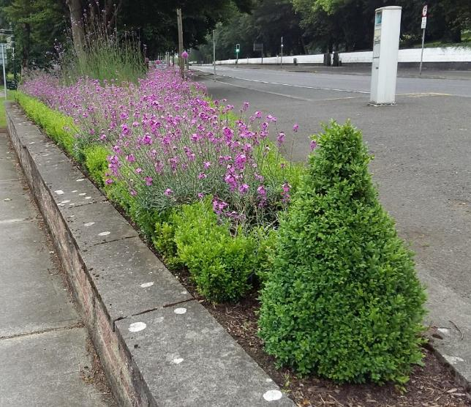
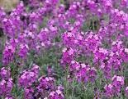
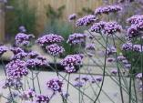
Erysimum var
Verbena bonariensis
Allium var
Buxus sempervirens
Kells - simple effective planter bed using mass planting with box edges.
wallflowers can also provide an important supply of nectar during the winter months.

Slide 47
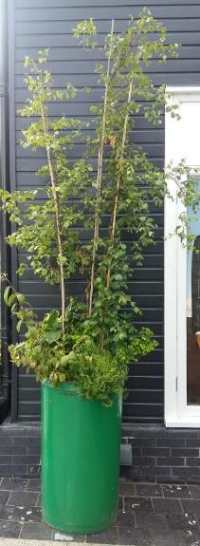
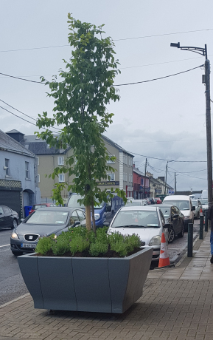
Use trees as ‘vertical bedding’
height seen above the street clutter and parked cars
Edgeworthstown TidyTowns

Slide 48
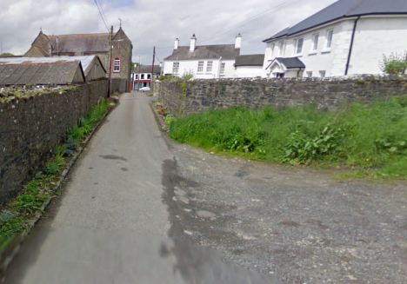
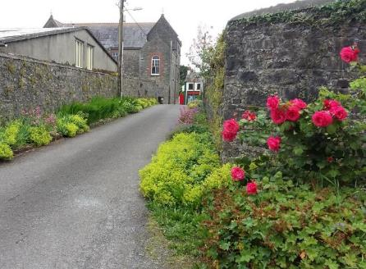
Athboy before and after

Slide 49
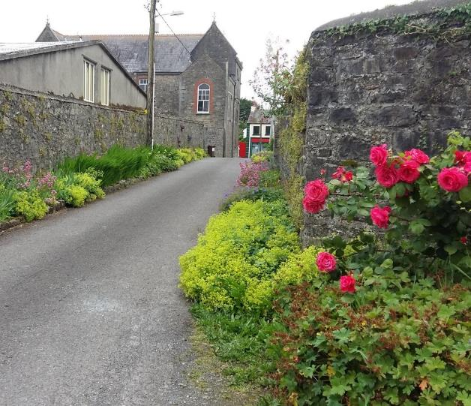
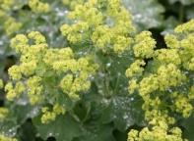
Alchemilla mollis
Geranium sanguineum
Rosa var
Athboy , Co Meath. succession of seasonal plants from early iris to geranium to late summer roses. Colour palette perfect for a pedestrian link to the main street along a beautiful stone walled lane

Slide 50
Any Questions? Thoughts?

